Slide 1
Basic Operations in Programing Languages
3.1.1.3 3.1.1.4 3.1.1.5 3.1.1.7 3.1.1.8

Slide 2
Lesson 1

Slide 3
Operation Categories
Arithmetic
Relational
Boolean
String Handling

Slide 4
Arithmetic Operation
+, -, /, ×
Division of Integers → answer = num1 \ num2; the quotient and remainder are calculated simultaneously
MOD → answer = num1 MOD num2
divide one number by another to find the remainder
Exponentiation (^) → answer = num1 ^ num2; 16 = 2^4
Repeated multiplication of a base number
Rounding → answer = Math.Round(num1)
Round up, round down, round to nearest d.p.
Truncating → answer = Math.Truncate(num1)
Shortening a value by cutting it off after a certain number of digits; equivalent to rounding down.
Random number generation: Several methods to do this; often number is
set to generate between two fixed values.
Use the backward slash
DIV
4 = 23\5
Randomize()
' The program will generate a
number from 0 to 50
number = Int(Rnd() * 50) + 1

Slide 5
Random Numbers ~ Method 1
RECAP
In Visual Basic, we can generate pseudo-random numbers using the Random class.
To start, declare a new instance of the Random class in the following way,
Dim rand As Random = New Random()
The following statement would make the variable myRandomNumber equal to an integer from 0 to 9,
myRandomNumber = rand.Next(10)
Another version of the Next method allows you to specify a range for your number. The following will generate a number from 0 to 9. The first number is the lowest value, the second number is one more than the highest,
myRandomNumber = rand.Next(0,10)
There is also the NextDouble() method. It returns a double greater than or equal to 0.0 and less than 1.0
myRandomNumber = randomNumber.NextDouble()

Slide 6
Random Numbers ~ Method 2
RECAP
When using the Rnd function, you should also use the Randomize() to give you a different number.
Randomize() uses the machine clock to set the initial value (called a seed).
Place the Randomize() before using Rnd() in a program:
Randomize()
number = Int(Rnd() * 50) + 1

Slide 7
Relation Operators
Description | In VB
Equal to | =
Less than | <
Greater than | >
Not equal to | <>
Less than or equal to | <=
Greater than or equal to | >=

Slide 8
Boolean Operators (Logical Bitwise Operators)
AND: conjunction = adds together the data
Outputs true if both inputs are true
OR: disjunction = a TRUE result is produced if any of the conditions are met.
Outputs true if either inputs are true
NOT: negation = reverses the input
Inverts the results so true becomes false and false becomes true
XOR: exclusive OR = TRUE results is produced when one or the other condition is met but not both.
True if either input is true but not if both inputs are true

Slide 9
Class Tasks & Homework
Complete Task 1 & 2
Click here for handout!

Slide 10
Lesson 2

Slide 11
String Handling
What is a string?
A sequence of characters and can actually be made up of text, numbers and symbols.
Actions that can be carried out on sequence of characters:
Length: number of characters in the string
Position: position of every character in a text string
Substring: a string within another string
Concatenation: adding string together
Character codes (e.g. ASCII, Unicode): a binary representation of a particular letter, number or special character.
String to Integer / Integer to String: CInt / ToString
String to Float / Float to String: CDbl / ToString
String to Date-Time / Date-Time to String: ToDateTime or CDate / ToString
**Click here for a handout for a list of string functions in VB.NET

Slide 12

ToString() - Method
ToString is the major formatting method in the .NET Framework.
It converts an object to its string representation so that it is suitable for display.

Slide 13
Integer.Parse
Converts Strings to Integer (only).
Example:
Dim text As String = "42"
' Convert string to integer value
Dim value As Integer = Integer.Parse(text)
* You could also use Convert.ToInt32

Slide 14
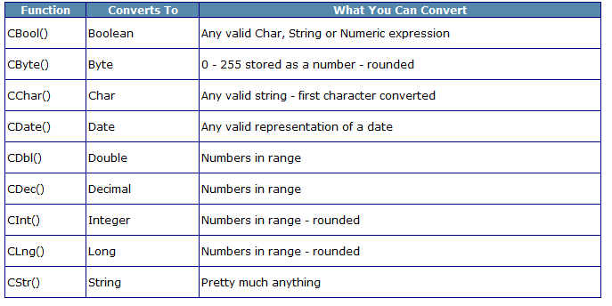
Explicit Convertions
Sometimes it is necessary to perform an explicit conversion.

Slide 15
Casting: CInt
Converts an unknown value (Numeric types(Double/Single), String, Boolean, Variant & Objects) to an Integer type & rounds up the number.
For example:
intValue = CInt(stringExpression)
Notes:
Casting also referred to as Coercing

Slide 16
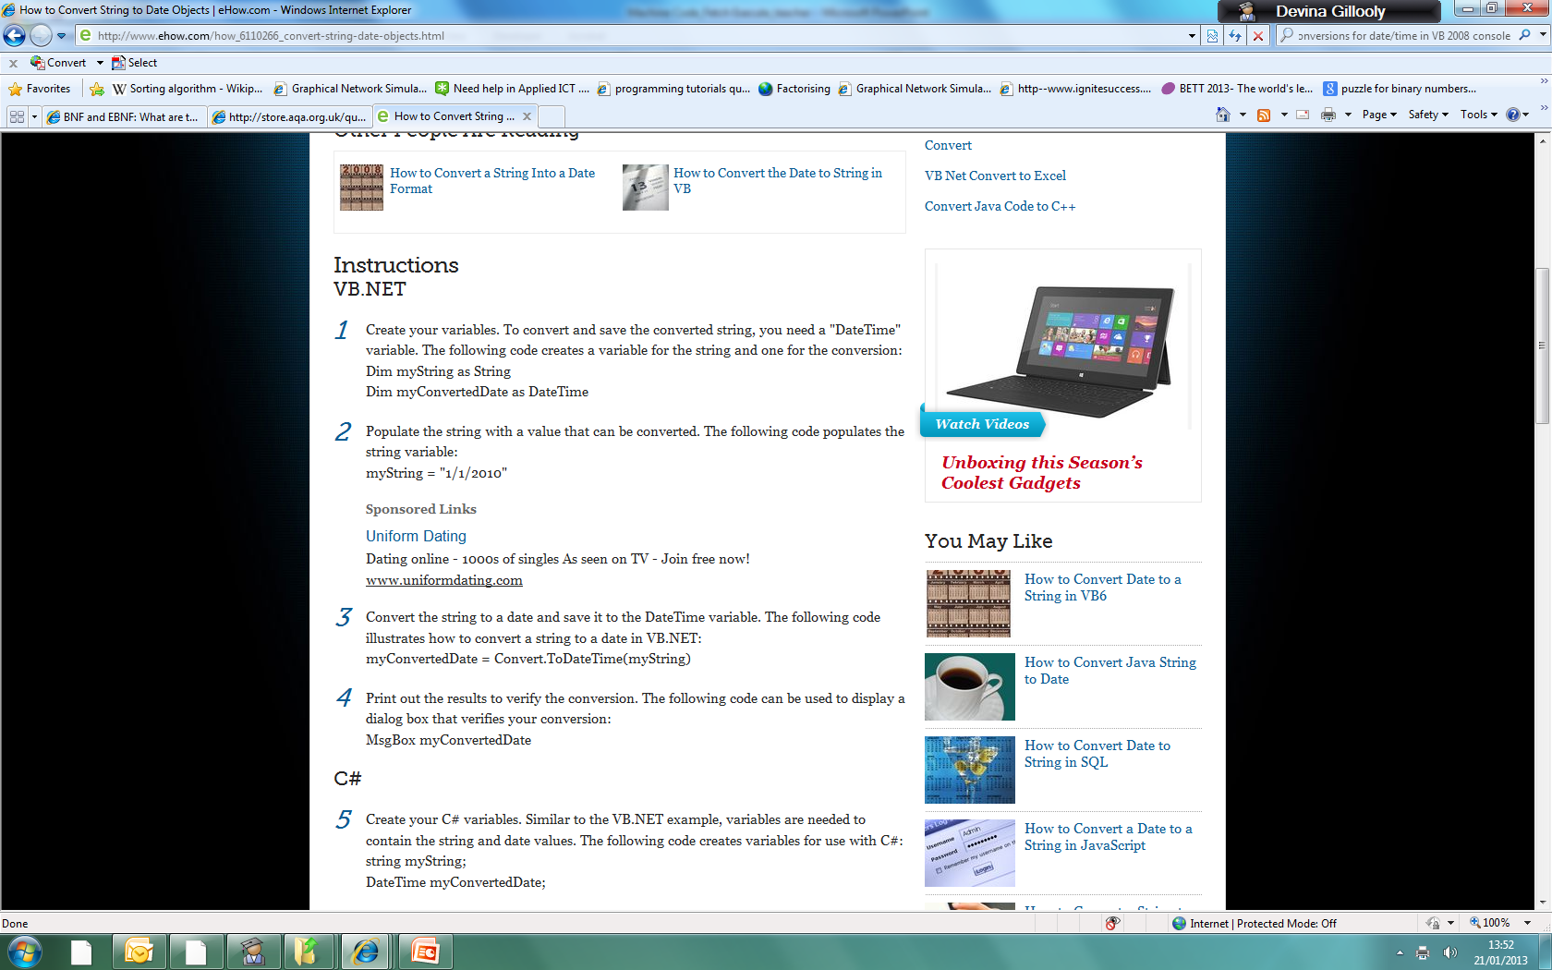
Converting String to Date Objects

Slide 17
Class Task & Homework
Complete Task 3
Click here for handout!

